Slide 1


Securitization and Baseload Transition
Legislative Energy Committee
11-13-2020
Julie Pierce – Vice President Strategy and Planning

Slide 2
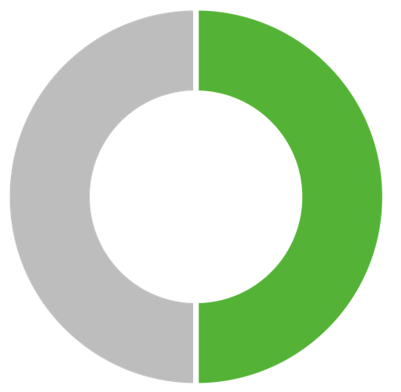
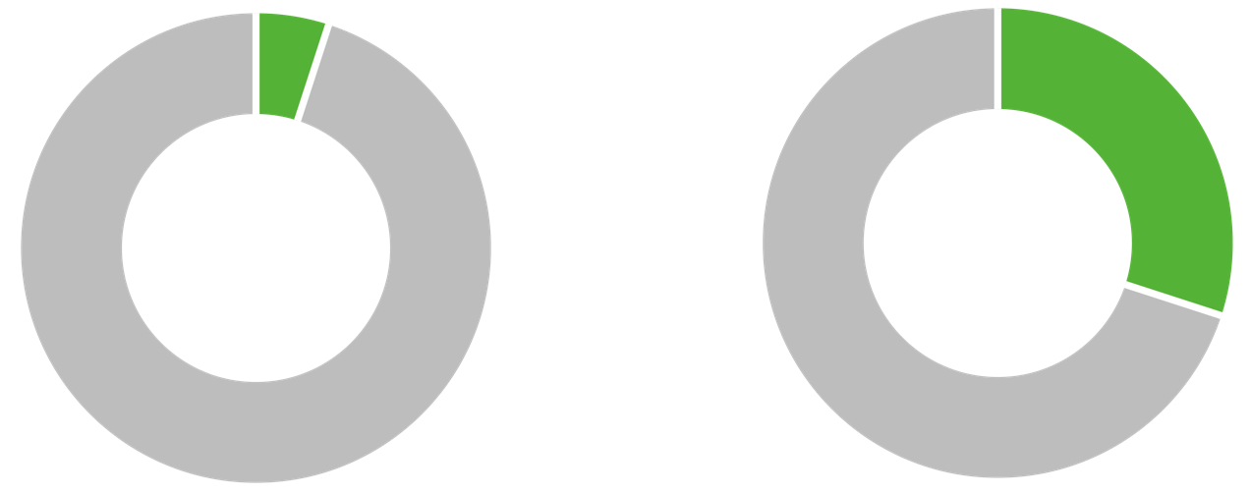
Leading Minnesota
in Renewables
2005
2019
2021
5%
Renewable
30%
Renewable
50%
No. 1 in Minnesota No. 2 in the Midwest*
Renewable
*Source: Navigant Consulting

Slide 3
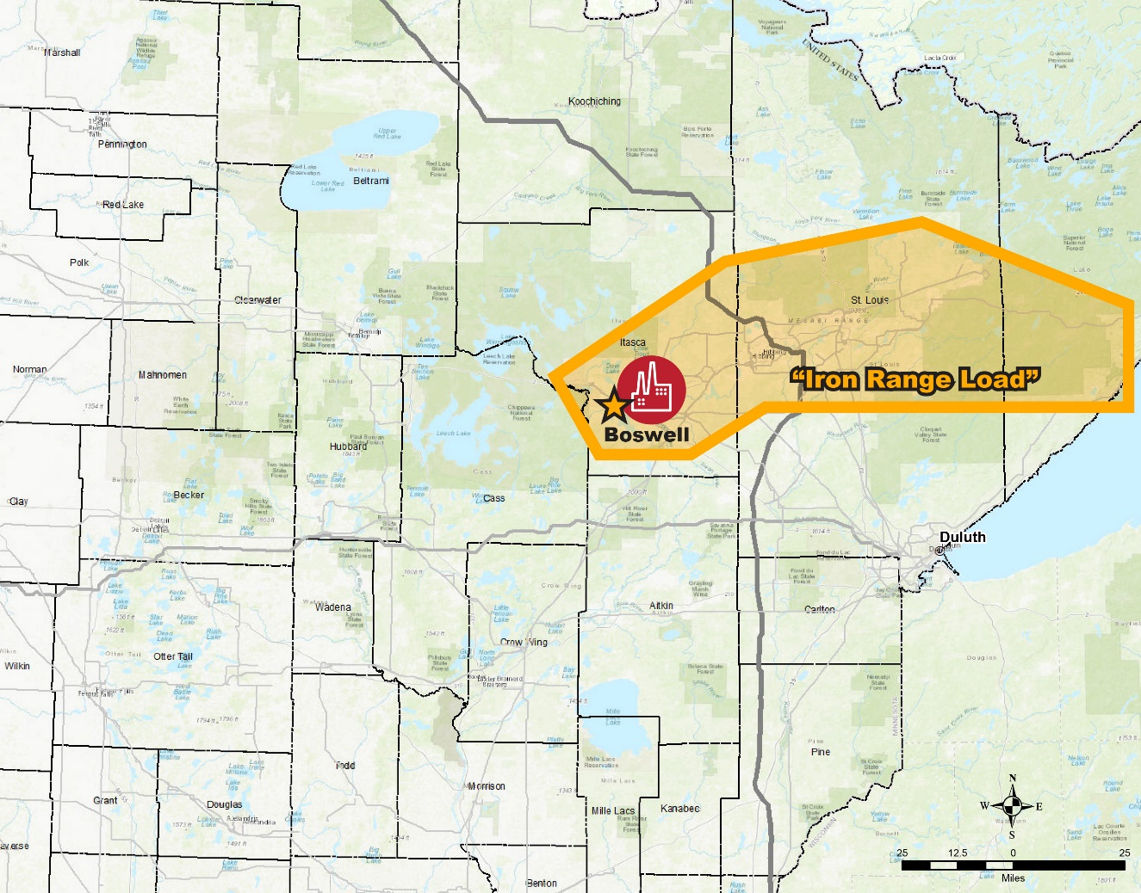
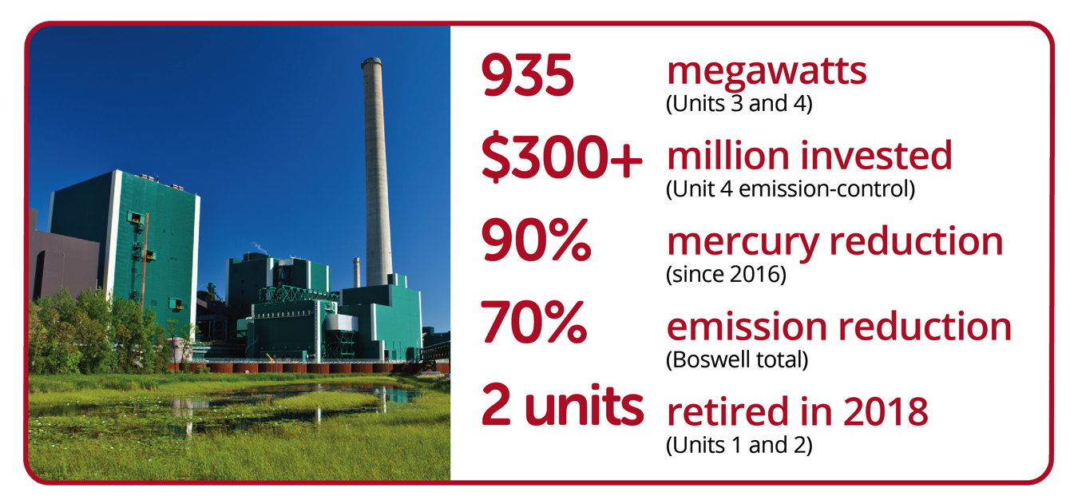
MP’s 2020 Baseload Study
Boswell Energy Center

Slide 4
Financial Tool: Securitization
Opportunities
Challenges
MP revenue volatility is high due to concentrated customer/revenue base
As a small utility achieving the refinancing benefits can be challenging - relative bond size will be important
Lower flexibility for regulators in future rate design
May reduce future utility earnings
Capital recycling can assist but introduces time, type, timing regulatory risk
May lower customer costs by refinancing utility debt and equity with higher rated, lower cost debt
May allow for new utility investment, transition assistance depending on structure of legislation

Slide 5
Financial Tool: Securitization
Mitigation
Next Steps
Evaluate Securitization along with other rate mitigation opportunities
Phase 2 Study to accompany Integrated Resource Plan
Structure securitization terms and sizes carefully
Implement regulatory or contractual measures to reduce revenue volatility
Allow for utility reinvestment for replacement options

Slide 6
Appendix

Slide 7



ALLETE/Minnesota Power
Ranks Highest in Renewable Energy
% of Renewable Cap-X Compared to Total Capital Expenditures 2020-2022
Source: Company public filings, i.e. Form 10-K, investor slide presentations; S&P Global article, https://www.spglobal.com/marketintelligence/en/news-insights/blog/financial-focus-wind-solar-capex-led-by-nextera-remains-major-component-of-utility-growth

Slide 8
